Slide 1
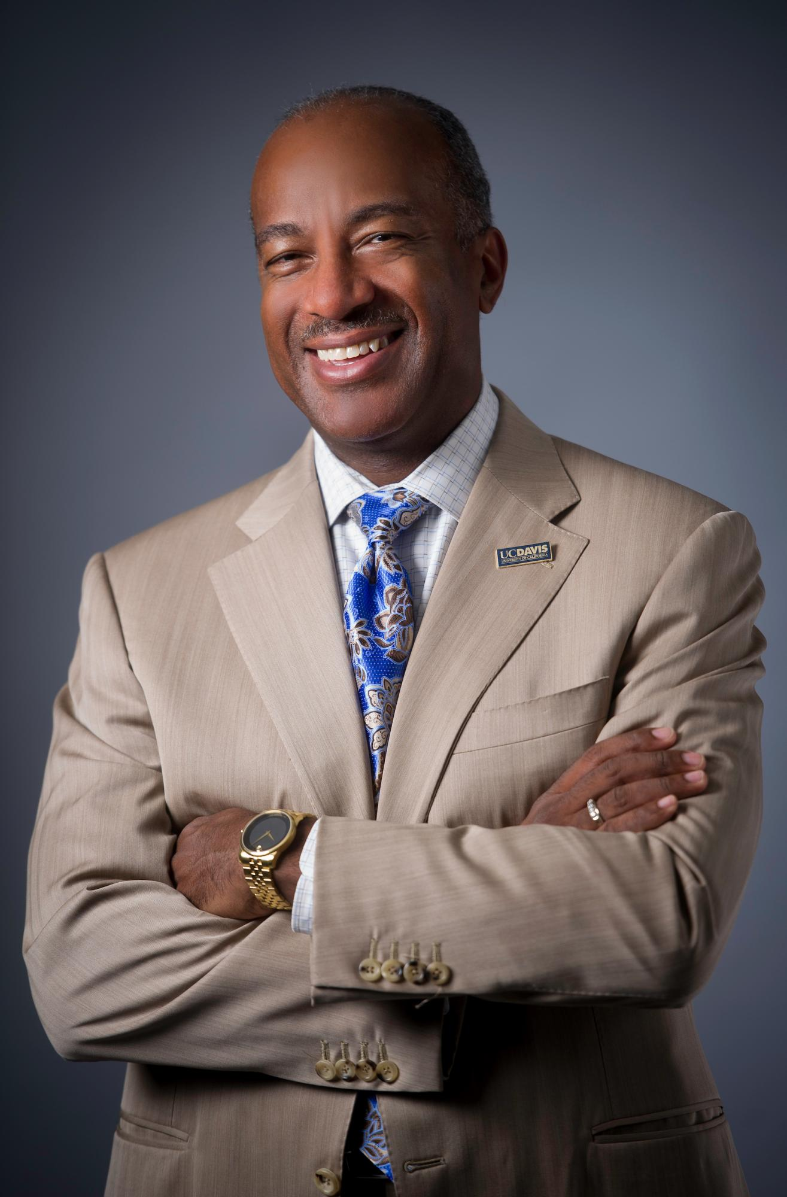
Excellence in Leadership
Chancellor Gary S. May
Washington State University
Wednesday, April 10, 2019
Notes:
• Thank you. It’s an honor to be here and share my leadership journey with you. First, I’d like to thank the Black Faculty and Staff Association for sponsoring this lecture series and your work to strengthen diversity. I’d also like to thank the Office of the President for their commitment to growing leadership and diversity on campus. Your support of this lecture series is greatly appreciated.
• I’ve carried values of diversity and inclusion since my earliest days as an undergrad at Georgia Tech. Those values have only strengthened through my career in academia. As leaders in higher education, it’s incumbent that we prepare our students for a workforce that’s becoming increasingly global in scope. Collaboration with people from a broad array of backgrounds is key.
• A culture of mutual respect is also needed far beyond the office. In these polarizing times, embracing diversity and inclusion is central for our humanity and progression as a society.
• But, what we often don’t talk about enough in terms of “diversity” are its practical benefits. “Diversity” isn’t just a good buzzword. To me, it’s at the root of innovation and technological advancement. The greater diversity we have in university research, the more likely we can make discoveries and solve problems. A wide mix of backgrounds, experiences and ideas helps make this happen.
• That’s why I’ve spent so much of my career focused on attracting and retaining students in higher education, particularly in the STEM fields of science, technology, engineering and math. As university leaders, we’re in a unique position to bring access, opportunity, and advancement for everyone. That’s how we build a better tomorrow.
• But first, I want to share my own personal journey through my life and leadership opportunities. I’ve been lucky to be surrounded by dedicated family members and mentors who were there for me during the ups and downs.
• So, let’s go all the way back to the beginning.

Slide 2
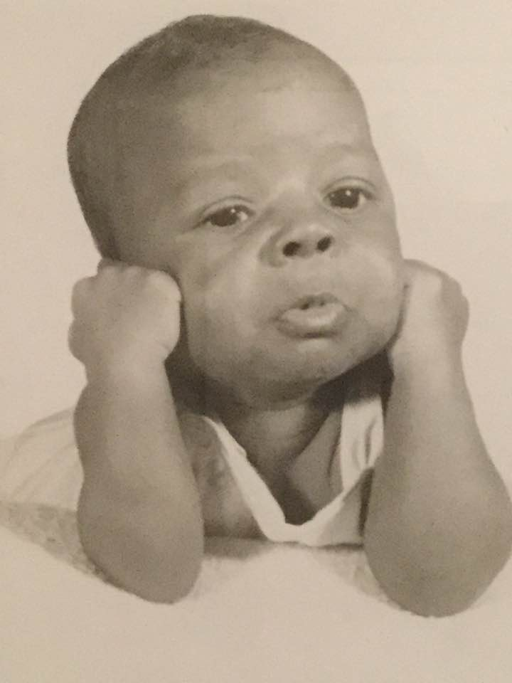
Notes:
• And I mean, all the way to the beginning. Yes, that’s me posing for the camera.
• I was born in St. Louis and raised by my parents, Gloria and Warren May.
• Unlike a lot of leaders in higher education, I come from a fairly humble background. My mom spent 40 years teaching in St. Louis public schools. My father was a postal worker. He didn’t get a college degree until later in life, but he was a very smart, very determined guy.

Slide 3
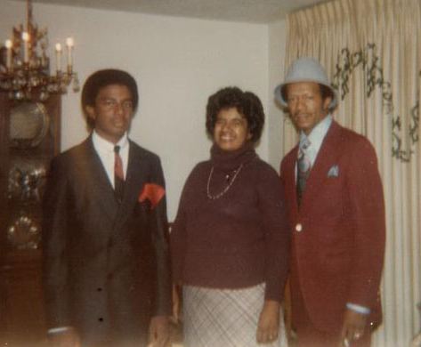
The May family: St. Louis in the late ‘70s
Notes:
• Here I am as a teenager with my mom and dad. This was taken in the late-1970s in St. Louis.
• Thank goodness my mom’s smile was big enough for both my dad and I. But, you can see my dad was pretty sharp. He certainly taught me the value of carrying yourself with confidence.

Slide 4
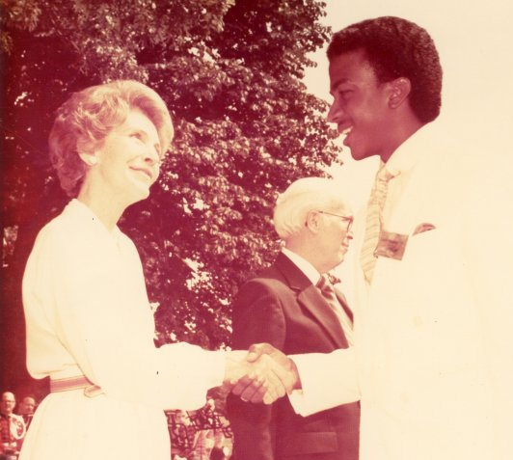
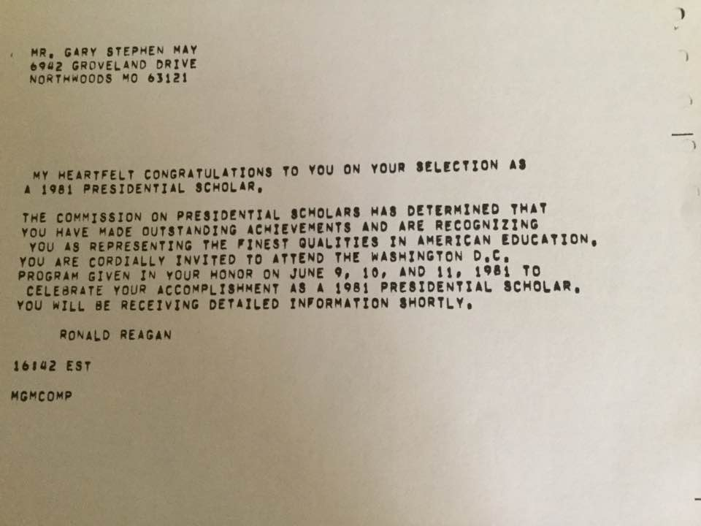
High School Honors
Notes:
• Education was a core value in the May family - and it still is. I was lucky to have an affinity for math and sciences while growing up. I often credit my early love of Legos and Erector sets for sparking the engineer in me. The extra dollar my dad slipped me for every “A” I got was also a good motivator.
• Either way, I took my studies seriously and was selected as a Presidential Scholar in high school.
• To the left is the note I received from President Ronald Regan. The other picture shows me shaking hands with First Lady Nancy Reagan at the Presidential Scholar reception. That was a really proud moment for my whole family, especially my mom.

Slide 5
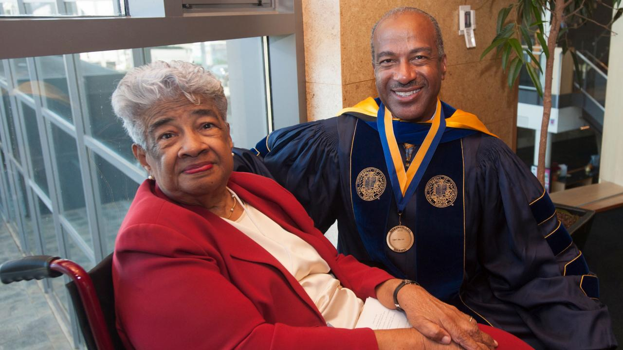
Inspiration then and now
Notes:
• My mom remains one of my greatest sources of inspiration. Here we are at my Investiture in 2017, the ceremony where I was sworn-in as UC Davis’ seventh chancellor. I’m also the first African American chancellor at UC Davis and the second in the entire University of California system.
• My mom was something of a groundbreaker, too. She was among the first to integrate the University of Missouri. I think of what she endured in her pursuit of higher education, and even now, I carry her lessons in tenacity and self-determination. Here’s what I mean.

Slide 6
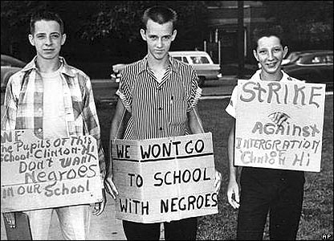
Rising above Jim Crow laws
Notes:
• My mom entered the University of Missouri during the era of Jim Crow laws. Those were the state and local laws that enforced segregation in the south and other parts of the country. It seems like Jim Crow laws were from long ago, but they really weren’t when you think about it. That was just one generation removed from us now.
• Anyways, when my mom showed up to the dorms for the first time, the house mother got really upset. She didn’t like that Black girls were going to be living there. She even questioned where they were going to shower.
• But, my mom never gave up, despite the hateful language and other incidents that came her way. She wasn’t going to let anyone get between her goal of earning a college degree.

Slide 7
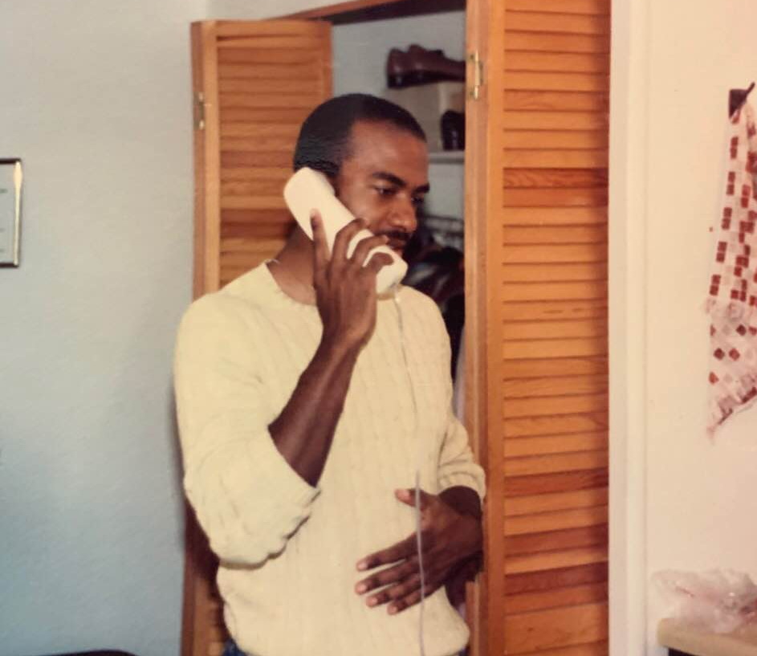
Finding my way at Georgia Tech
Notes:
• I learned quickly to follow her example when I started as an undergrad at Georgia Tech. That is, I had to stay focused and learn to rise above adversity.
• On my very first day at the dorms, I found the “n-word” written on my door. My mom and dad were nervous when they heard about this, but I pressed on – just like my mom did in college.
• To the students here today, I encourage you to do the same. You can’t let the bigots win, whether they’re trying to deflate you through racism, sexism or homophobia. Keep pushing, because you don’t know the rewards at the end of the road - and by the end you might help make a difference.
• Now, I had another awakening while I was earning my degree in electrical engineering. I’d look around the laboratories and lecture halls and realize I was usually the Black person in the room. That included fellow students, professors, research partners – you name it. It just didn’t feel right. That was my motivation to make a difference. Like the author Toni Morrison once said, “If there’s a book that you want to read, but it hasn’t been written yet, then you must write it.”
• So, that’s what I did - and I looked for people to inspire and mentor me.

Slide 8
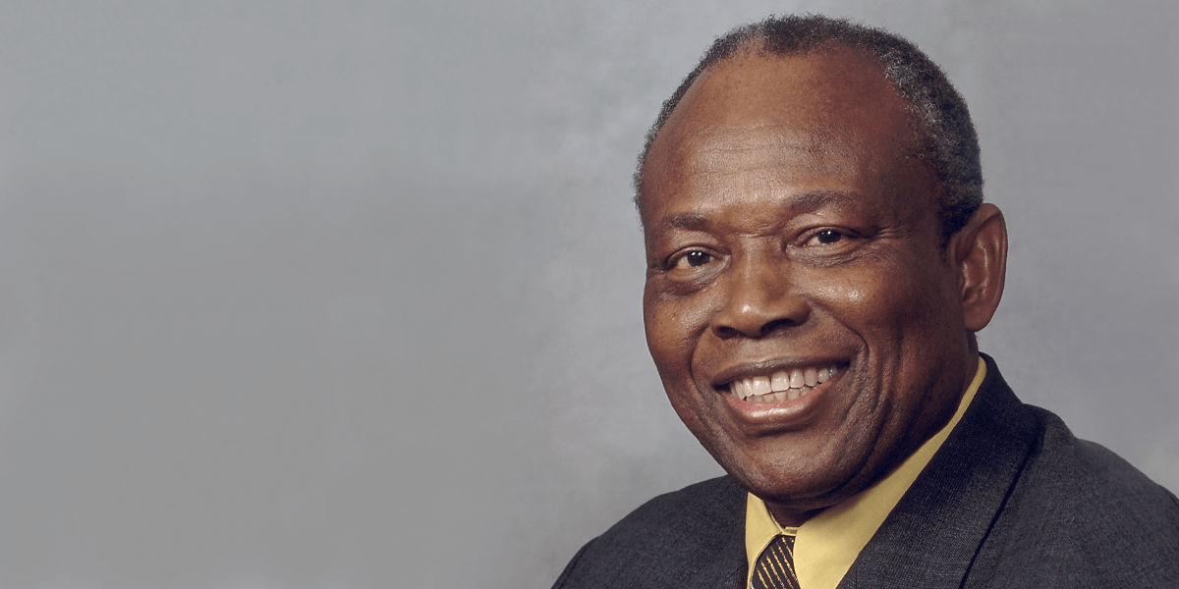
A key role model: Dr. Augustine Esogbue
Notes:
• All of us have needed a good mentor to get where we are today. One of my favorite quotes about mentorship comes from the former surgeon general, Joycelyn Elders, who said, “You can’t be what you can’t see.”
• As an undergrad, I saw a whole new set of possibilities from the man pictured here. This is Dr. Augustine Esogbue, the first black engineering professor at Georgia Tech. He had it all … the sharp clothes, the fancy cars, the superior intellect. We all wanted to be like “Dr. E.”
• He took me under his wing, and my world opened up through his influence. I could see living proof of a Black man finding great success and respect in the engineering field. No matter how much adversity I might face, I knew I could reach my goals with hard work and a solid support system.

Slide 9

Notes:
• Along with finding a mentor, I wanted to build community with my peers. I found an incredible source for that with the National Society of Black Engineers. This organization was founded in the mid-1970s, and I joined a few years later as an undergrad at Georgia Tech.
• The NSBE was a game changer for me. It helped me connect with others who had the same passion for engineering. We could relate to each others’ struggles and stories of feeling isolated. We were looking for mentors and wanted to help others along the way as well.
• The NSBE allowed me to hone my leadership skills. I served national vice chair from 1985 to 1987, and national chair from 1987 to 1989. I worked hard to grow the organization and helped the NSBE get ownership of its first headquarters in Alexandria, Virginia.
• My connection to the NSBE continues to this day. In fact, I was in Detroit recently to attend their annual convention for about the 30th year. The real joy is seeing all of your old friends and former students doing big things.

Slide 10
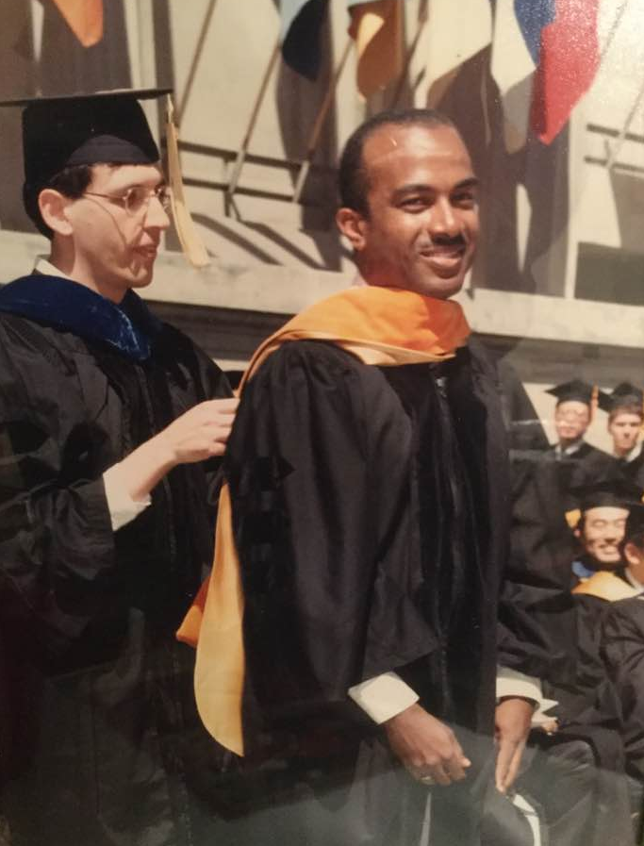

Graduating and growing leadership at UC Berkeley
Notes:
• So, through my involvement with the NSBE, I entered graduate school feeling pretty confident about the next chapter of my life.
• Here’s a flashback to my graduation from UC Berkeley, where I earned my masters and Ph.D and electrical and computer engineering.
• I think of this time as an important part of my development - not just academically, but as a key period in growing my leadership skills.
• I helped form the Black Graduate Students Association not long after I entered UC Berkeley. It was clear that African American students were drastically underrepresented in graduate school, especially in the STEM fields of science, technology, engineering and math.
• In fact, when I got my Ph.D. from Berkeley in 1991, I was one of only 31 African Americans that year who had earned a doctorate in the field of engineering. I’m talking 31 in the entire United States!

Slide 11
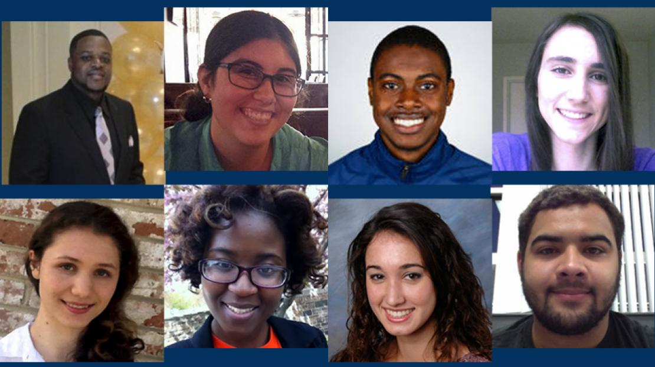
SUPERB @ UC BERKELEY
Notes:
• So, along with supporting peers in the Black Graduate Students Association, I worked to create other programs as well.
• One of those was SUPERB, which stands for Summer Undergraduate Program in Engineering Research at Berkeley. Our goal was to bring together a diverse, talented pool of students and motivate them toward graduate school.
• I’m proud to say the SUPERB program continues to this day, as shown by these recent participants.

Slide 12
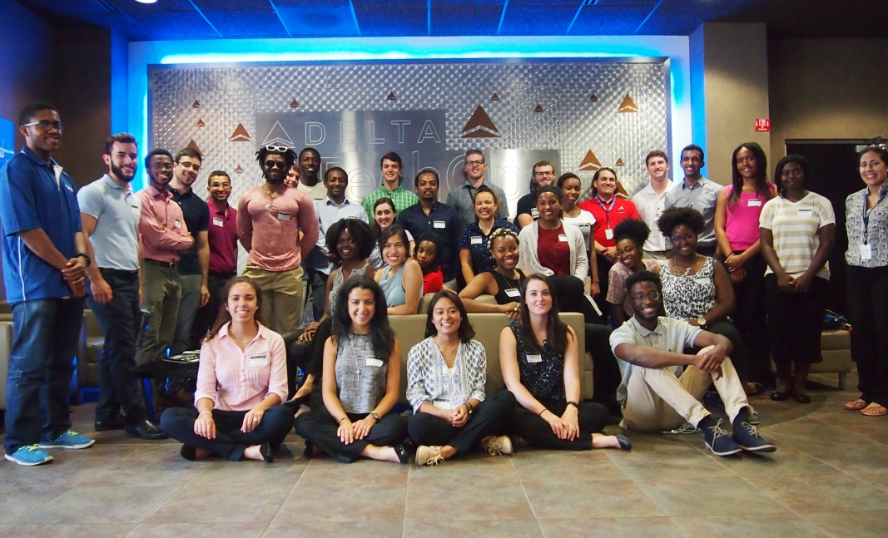
SURE: Bringing diversity to graduate studies
Notes:
• I wanted to re-create the spirit of SUPERB when I joined the faculty of Georgia Tech in 1991.
• One program I helped create was the Summer Undergraduate Research in Engineering/Science - otherwise known as the SURE program.
• With the help of a $3 million grant from the National Science Foundation, we hosted underrepresented students at Georgia Tech to perform research. Ultimately, our goal was to see them pursue a graduate degree. And that’s exactly what happened. During that time, we saw over 73% of SURE students enroll in graduate school.
• I also served as the co-creator and co-director of two programs: the Facilitating Academic Careers in Engineering and Science (FACES) and the University Center of Exemplary Mentoring (UCEM) programs. The goal for both of these programs was to increase the number of underrepresented Ph.D. recipients from Georgia Tech.
• I’m proud to say we were successful. Over the duration of FACES, more than 400 minority students received Ph.D. degrees in science or engineering at Georgia Tech. At the time, that was the most in such fields in the nation.

Slide 13
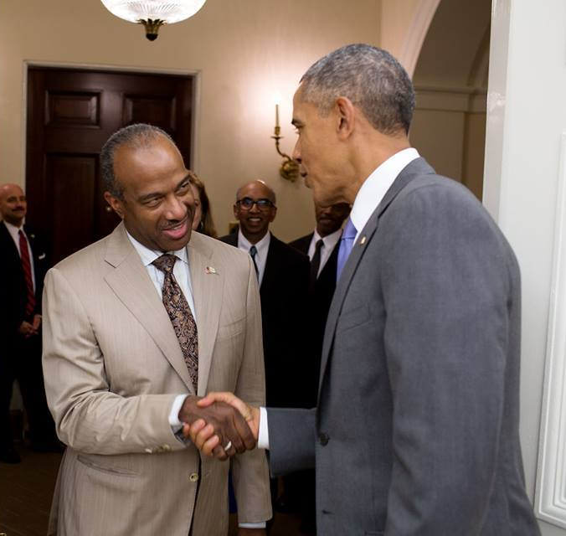
Honored by President Obama
Notes:
• Now, my dad used to say that one day I’d be president. That didn’t happen obviously, but I did meet one up close.
• In 2015, I received the Presidential Award for Excellence in Science, Mathematics and Engineering Mentoring from President Barack Obama. This was due to my efforts in supporting underrepresented students at Georgia Tech and the successes we achieved.
• Receiving that award from President Obama made me reflect on the people who’d helped bring me to this point. I thought of my parents, of course, and Dr. E from Georgia Tech. I thought of my wife, LeShelle, and our two daughters, Simone and Jordan, who’d brought even more love and support to my life.

Slide 14
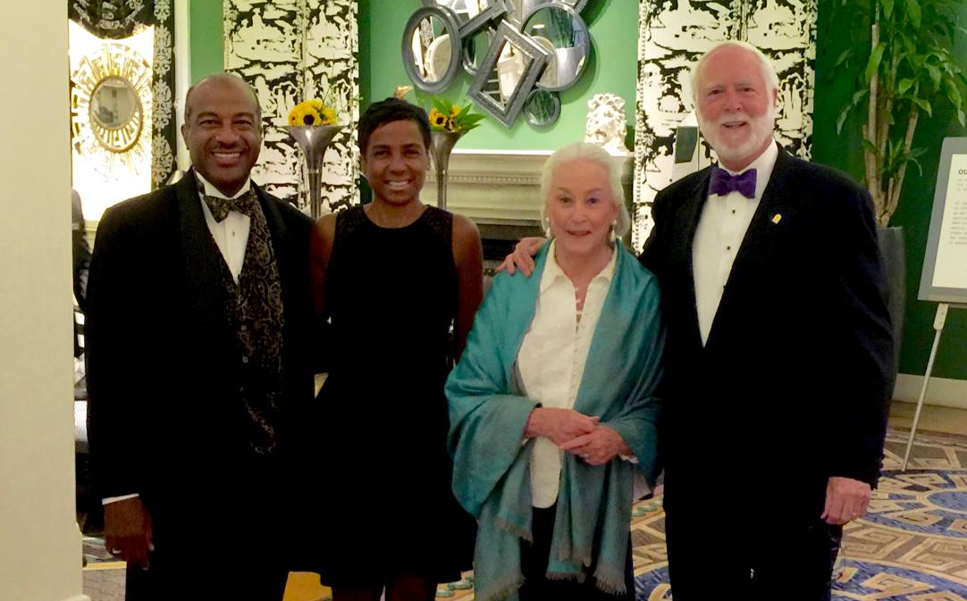
Lessons in leadership from Wayne Clough
Notes:
• I also thought of the man on the far right, Wayne Clough, President Emeritus of Georgia Tech.
• Our relationship goes back more than two decades. In 2002, he gave me a pivotal opportunity by selecting me as faculty executive assistant at Georgia Tech. I was something like a chief-of-staff for Wayne. I learned about high-level administrative responsibilities in academia, and how complex organizations like these are run.
• Wayne taught me a lot about effective leadership. I learned that a president or chancellor of a university isn’t much different than being a mayor. You have a lot of people with many diverse interests competing for your time. You have to be diplomatic but decisive in tough situations. And, you need to set the example and tone for others to follow.
• He also taught me that an effective leader needs to be a good listener. You don’t need to be the kind of Type A personality who likes to hear themselves talk and own the room. What matters more is hearing people out, processing that information, and encouraging others to collaborate to find solutions.
• More than anything, Wayne taught me the value of developing a good team. Surround yourself with the right people, and you’re likely to find all kinds of success.

Slide 15
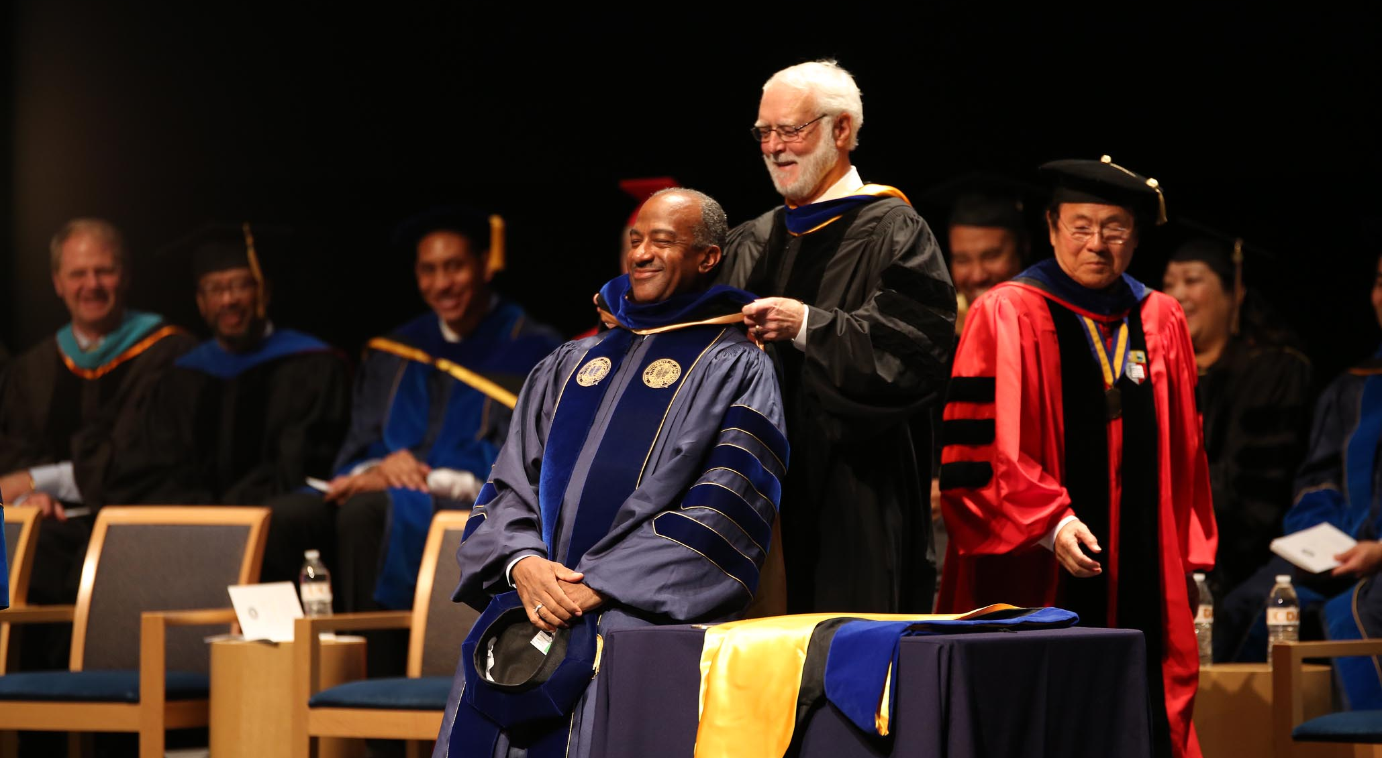
UC Davis: a new level of leadership
Notes:
• I carried all these lessons with me to UC Davis. I’d had a great run at Georgia Tech, such as serving as dean for the College of Engineering. I’d also spent six years as the Steve W. Chaddick School Chair of the School of Electrical & Computer Engineering.
• But, I couldn’t pass up the opportunity to lead UC Davis. We’re currently ranked as the #5 public university in the nation. We’re located in the heart of Northern California, just about 10 miles from Sacramento and its center of political power. We also fill a pipeline of talent to the Silicon Valley and other tech hubs around the San Francisco Bay Area.
• I was also attracted to UC Davis for its inclusive spirit and diverse community. California’s demographics are changing rapidly and one of my goals is making sure our student body, faculty and staff mirror the state’s population.
• That’s not to say everything’s been easy. Race has been a factor in my career, and I don’t think any of us will ever get to the point where it’s not a factor –– certainly not in my lifetime. We have to acknowledge that. But that doesn’t mean we stop trying. We need our allies to speak up and push back on biases that exist.
• Even now, there are circumstances where I’m recognized as a leader of a university - and there are circumstances where I’m just another Black man. Some of those even intersect.
• I’ve shown up to meetings where people openly questioned why I was there. One time I was attending a meeting of university presidents and chancellors and someone asked me, “What’s your role at UC Davis?” Well, it’s a presidents and chancellors meeting so they should’ve have needed to ask, right?
• But as I said earlier, my parents encouraged me to stand up for myself, to speak out and to be proud of who I am. Education was the great starting point for them. They wanted me to be compassionate and have empathy for others as well.
• I’ll take it a step further. As leaders in higher education, we must support diversity not just for social equity but for social outcomes as well.
• So, now that I’ve shared my personal journey, I want to broaden the scope in this final section. I’d like to give some concrete examples of why diversity matters and why it should be encouraged by educators, particularly at research universities like Washington State University. Some of these examples might seem minor, while others have more serious implications. But all of them point to biases that stifle our innovation.
• Here’s what I mean.

Slide 16
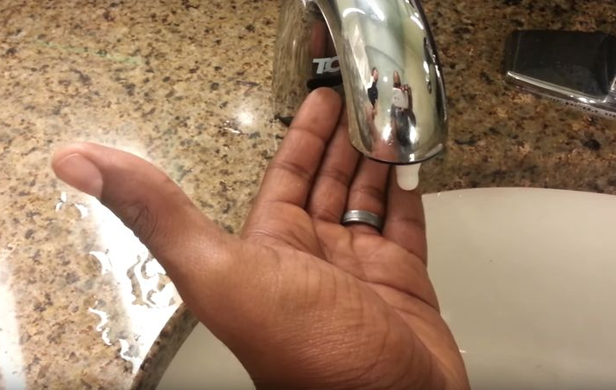
Practical needs for diversity: Automated soap dispensers
Notes:
• Let’s start with automated faucets and soap dispensers.
• Even in some restrooms today, if I put my hands in the sink with my palms down, I do not get soap or water. Why? Because the dispensers are not calibrated for the darker pigmentation on my skin.

Slide 17
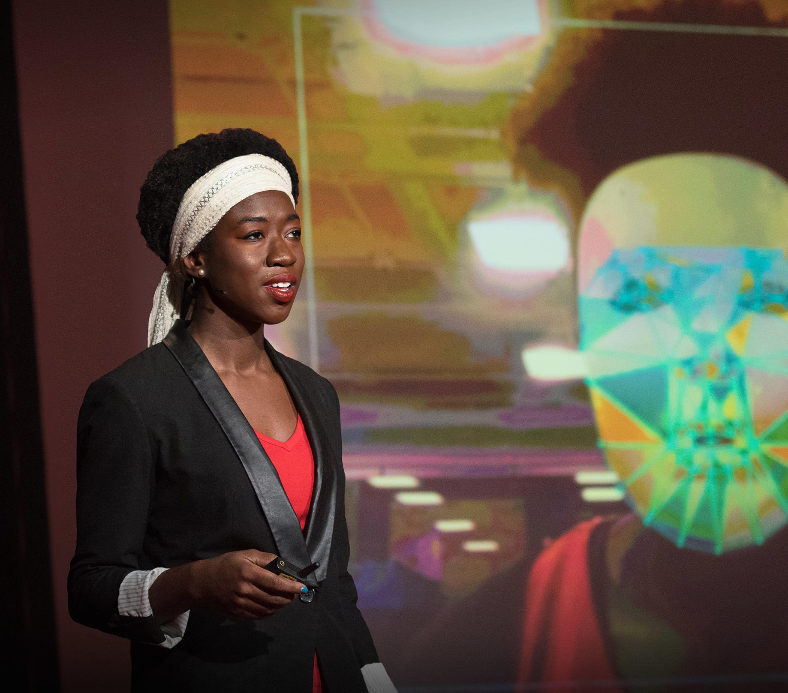
Racial biases in facial recognition technology?
Notes:
• Here’s another. We’re finding that some Artificial Intelligence programs used for facial recognition have racial and gender biases.
• One researcher, an African-American woman, tested various facial recognition systems while wearing a white mask to hide her features. She found the systems worked better on men’s faces compared to women. She also found they worked better on lighter-toned faces. In fact, she recorded error rates up to 47% for darker skinned women like herself.
• On a side note, I’d like to add that the researcher here, Joy Buolamwini [Buo-Lam-Wini], was one of my undergraduate students at Georgia Tech.

Slide 18

Driverless cars and detecting pedestrians
Notes:
• Here’s a final example that’s a little scary. A new study from Georgia Tech found that people of color are more likely to get hit by a driverless car. Like the facial recognition technology I just mentioned, driverless cars may better detect pedestrians with lighter skin than those of us with darker skin pigment.
• Now, these are just a few quick examples, but they make a clear point. Diversity, as a practical matter, leads to better outcomes. If there were diverse engineers on those design teams, they may not have overlooked those particular glitches.

Slide 19
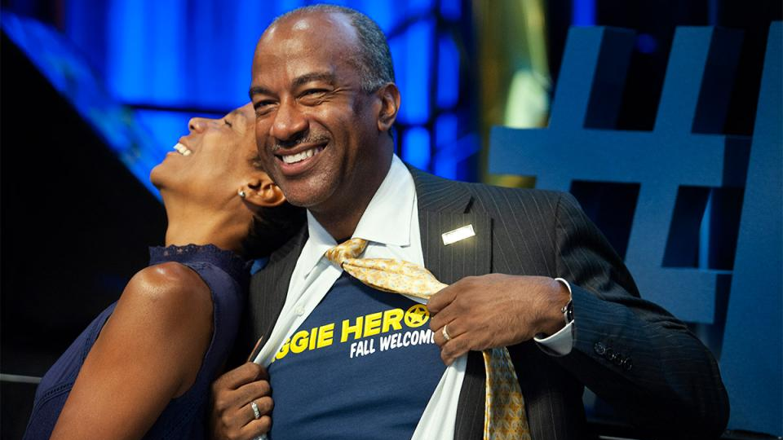
Notes:
• So, I encourage you all to think broadly. Think boldly and heroically. Think of how society benefits when as many people as possible have access to higher education.
• And most importantly, think about your gifts of mentoring and leading by example. That’s one of my favorite parts of being a chancellor. I’d always loved helping others succeed, and now I have the ability to do that on a much wider scale - like with the 39,000 students we have at UC Davis.
• Again, thanks so much for your hospitality and the invitation to be here today. I’ve enjoyed this opportunity to reflect on the people and events that shaped my career, and learn more about your campus.
• So, keep striving. Keep up your efforts with diversity and inclusion. Keep on leading and empowering the next generations of students, no matter where they come from.
• Now, if time allows I’m more than happy to take your questions. Thanks again, Washington State University!

